Slide 1

CSCI 476: Computer Security
Computer Systems Review
Reese Pearsall
Fall 2024
*all images are stolen from the internet
https://www.cs.montana.edu/pearsall/classes/fall2024/476/main.html

Slide 2
Announcements
TA
Nishu Nath
nishu.nath@student.montana.edu
Office Hours: Tuesdays 3pm – 5pm
Location: Barnard 259
Lab 0 posted→ Due Sunday September 8th
I want to make sure everyone can get something working
Stuff this week is posted in a Brightspace announcement (course website is broken atm)

Slide 3

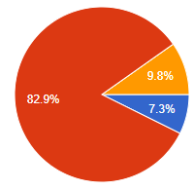
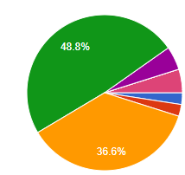
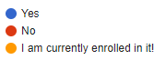
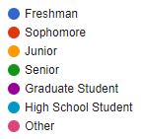
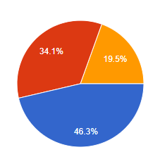
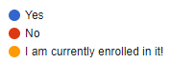
Course Questionnaire
Most people are comfortable with C and the command line, which is good ☺
“This class seems relevant and interesting”
“I am Stressed”
“I am working full-time”

Slide 4
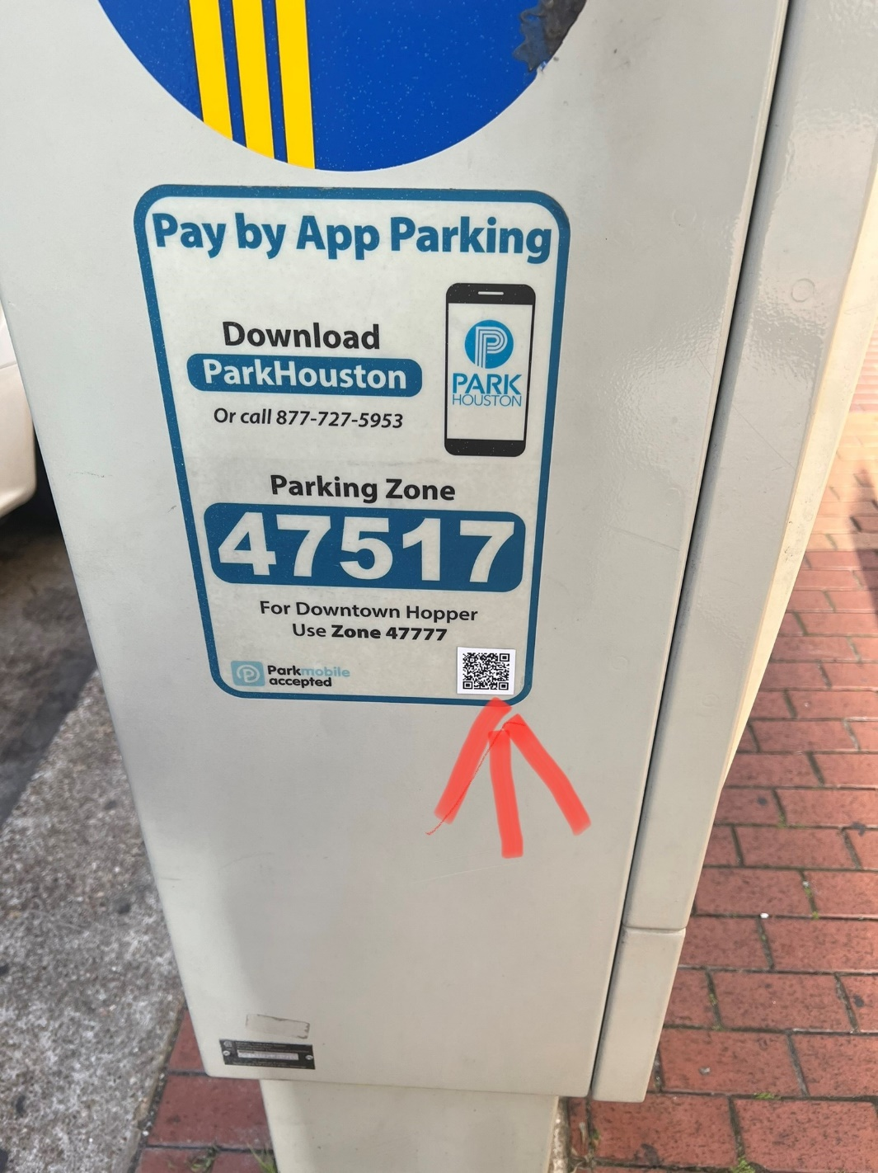
In the news: QR Codes
Malicious Actors are placing QR code stickers near public parking structures and tricking people to enter credit card information or download malware
URLs are embedded in QR codes, and by clicking on a URL, that is enough to initiate a download or send them to a fake website
QR codes are used for many things (some good things), but be careful when scanning an unknown QR code.

Slide 5
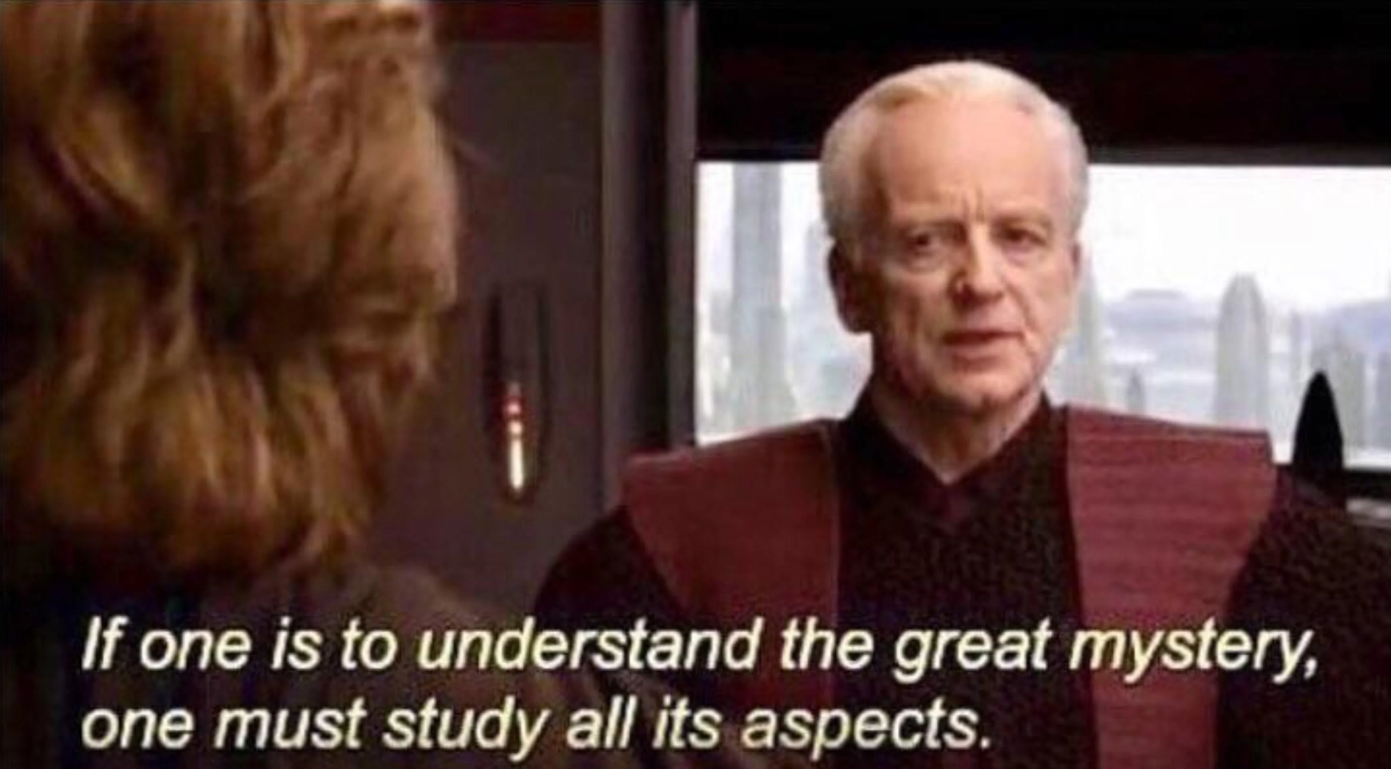
Computer Systems Review
To understand the technical aspects of security, we must have a good understanding of how computers work

Slide 6
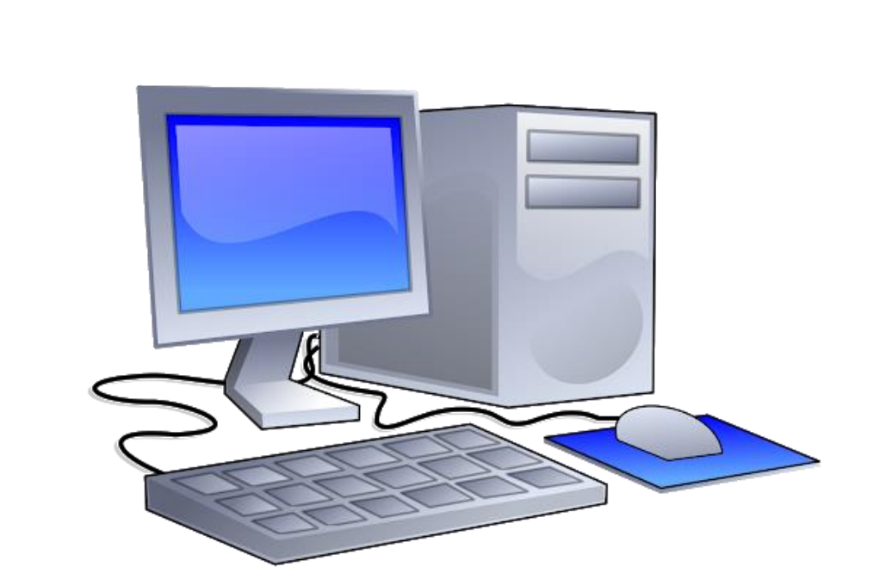
What is a computer?

Slide 7

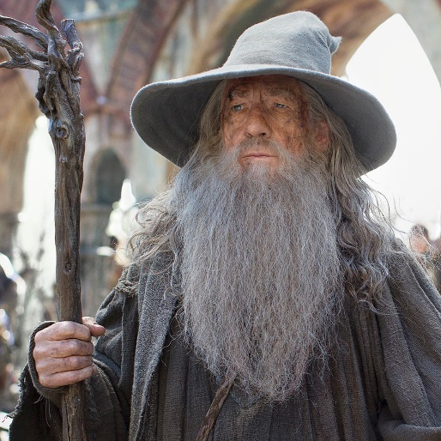
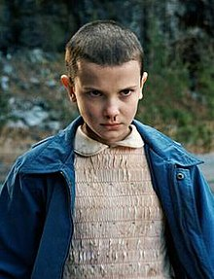
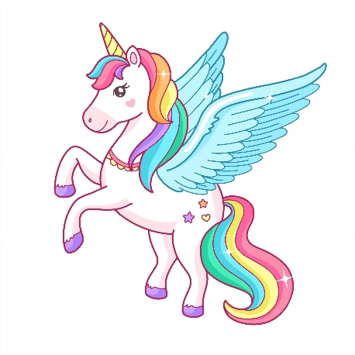
What is a computer?
A magical box that does stuff

Slide 8
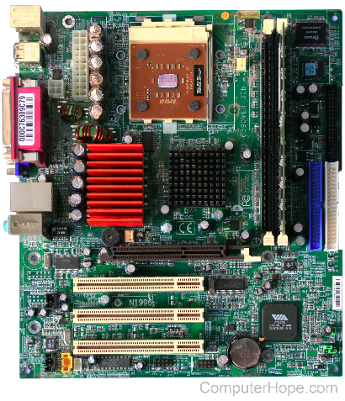
What is a computer?
A semi-magical box that does stuff executes instructions

Slide 9
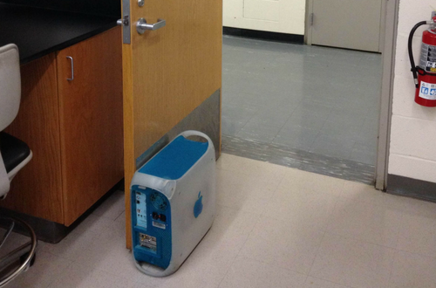


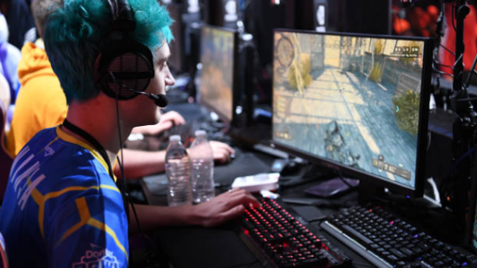

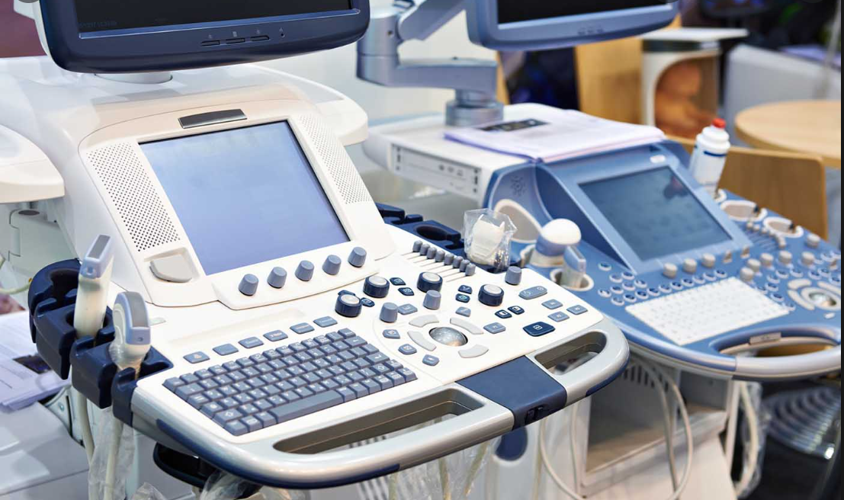

What is so magical about a computer?
We use computers every day for many different things

Slide 10


What is so magical about a computer?
Big Idea
Computers only understand instructions in the form of 0s and 1s (binary)
01010111 01100101 01101100 01100011 01101111 01101101 01100101 00100000 01110100 01101111 00100000 01000011 01010011 01000011 01001001 00100000 00110100 00110111 00110110
Welcome to CSCI 476

Slide 11
How does this happen?
From a high level, we will divide a computer system into two parts
???????
??????

Slide 12
How does this happen?
From a high level, we will divide a computer system into two parts
???????
I. Hardware
Hardware

Slide 13
How does this happen?
From a high level, we will divide a computer system into two parts
Software
Hardware
Software
Hardware

Slide 14
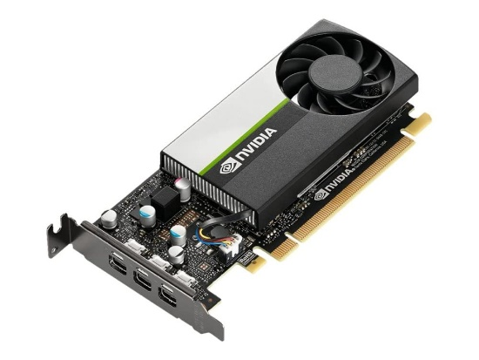
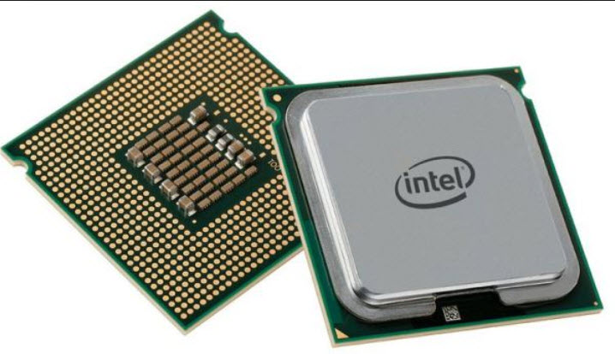
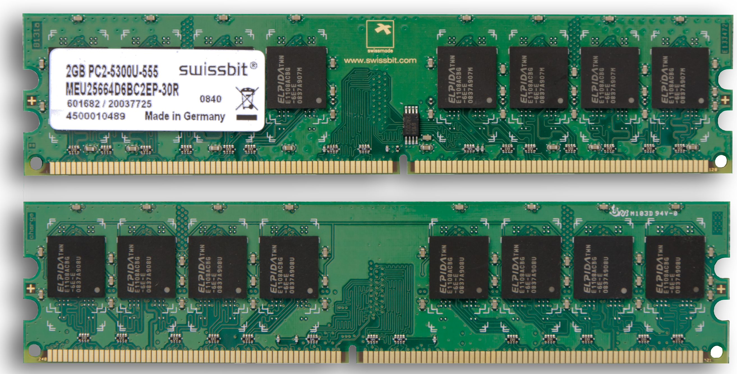
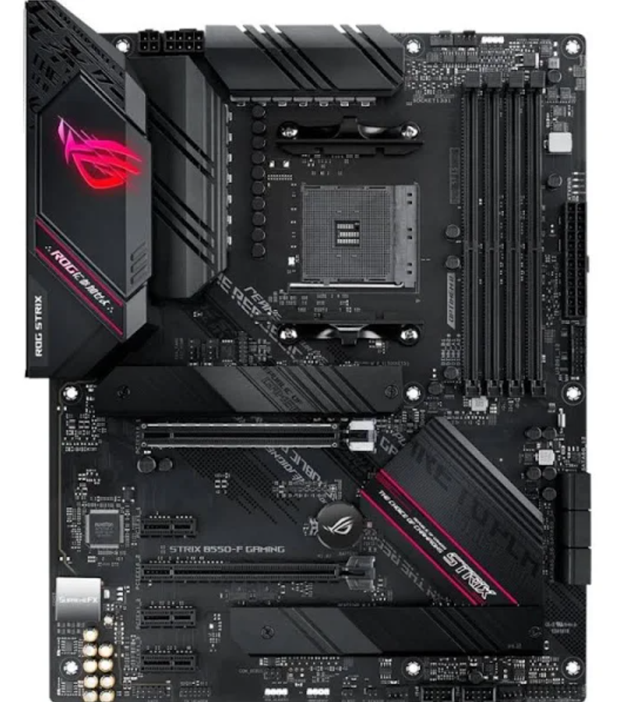
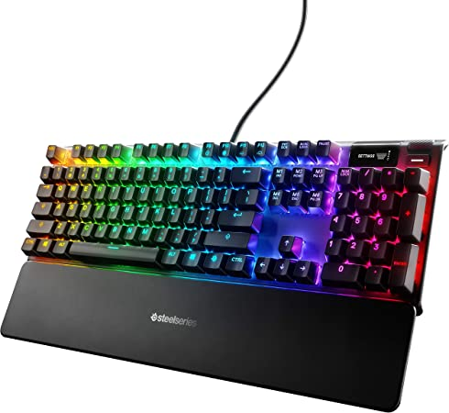
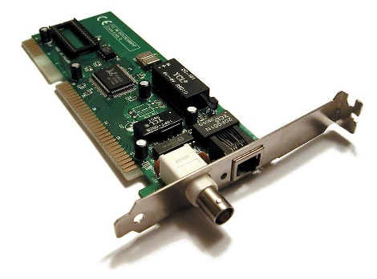
I. Hardware
The physical parts of a computer

Slide 15
I. Hardware
CPU
Memory

Slide 16
I. Hardware
Brain with no short-term memory
Scratch Pad
CPU
Memory

Slide 17
I. Hardware
Brain with no short-term memory
Scratch Pad
CPU
Memory
Executes instructions

Slide 18

I. Hardware
Brain with no short-term memory
CPU
How does it “execute” instructions?
It is sent instructions from another part of the computer
Executes instructions

Slide 19
I. Hardware
Brain with no short-term memory
CPU
How does it “execute” instructions?
It is sent instructions from another part of the computer
Executes instructions
01001100000000110100011100001010

Slide 20
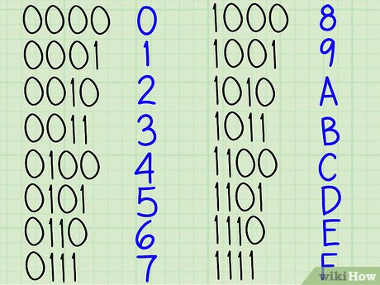
I. Hardware
Brain with no short-term memory
CPU
How does it “execute” instructions?
It is sent instructions from another part of the computer
Executes instructions
00000000101000010001100000100000
00 A1 18 20
00 A1 18 20
Hex(hexadecimal) is a common representation for binary

Slide 21
I. Hardware
Brain with no short-term memory
CPU
How does it “execute” instructions?
It is sent instructions from another part of the computer
Executes instructions
00000000101000010001100000100000
What does this instruction do?????

Slide 22
I. Hardware
Brain with no short-term memory
CPU
How does it “execute” instructions?
It is sent instructions from another part of the computer
Executes instructions
00000000101000010001100000100000
Opcode

Slide 23
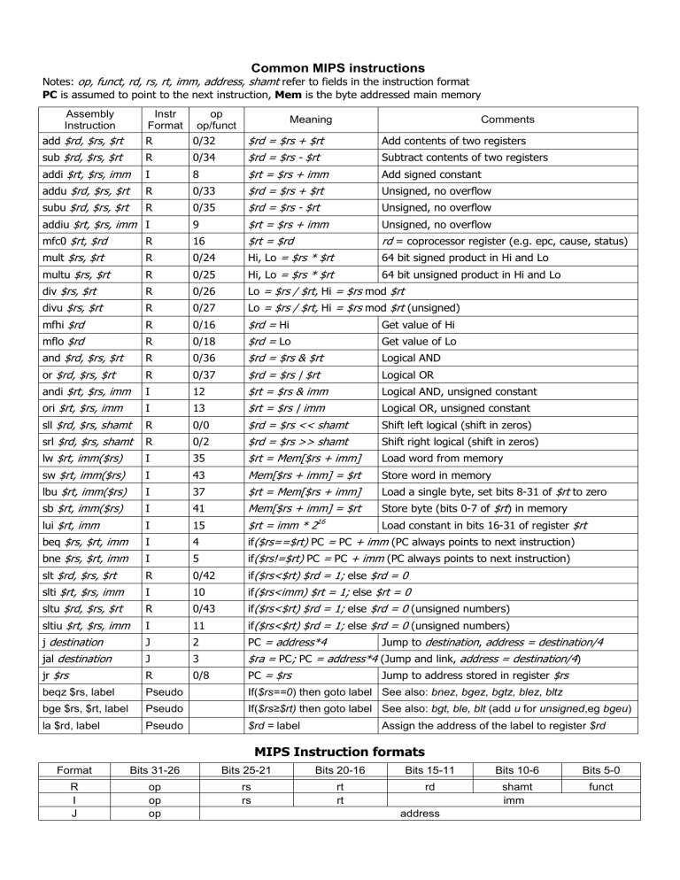
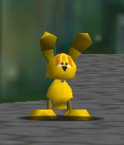

I. Hardware
Brain with no short-term memory
CPU
How does it “execute” instructions?
It is sent instructions from another part of the computer
Executes instructions
00000000101000010001100000100000
Opcode

Slide 24
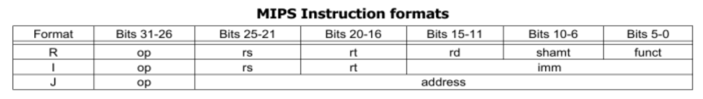









I. Hardware
Brain with no short-term memory
CPU
How does it “execute” instructions?
It is sent instructions from another part of the computer
Executes instructions
00000000101000010001100000100000
Opcode

Slide 25
I. Hardware
Brain with no short-term memory
CPU
How does it “execute” instructions?
It is sent instructions from another part of the computer
Executes instructions
00000000101000010001100000100000
Must decipher what instruction to execute
Opcode

Slide 26
I. Hardware
Brain with no short-term memory
CPU
How does it “execute” instructions?
It is sent instructions from another part of the computer
Executes instructions
00000000101000010001100000100000
Must decipher what instruction to execute
Opcode
$rs

Slide 27
I. Hardware
Brain with no short-term memory
CPU
How does it “execute” instructions?
It is sent instructions from another part of the computer
Executes instructions
00000000101000010001100000100000
Must decipher what instruction to execute
Opcode
$rs
$rt

Slide 28
I. Hardware
Brain with no short-term memory
CPU
How does it “execute” instructions?
It is sent instructions from another part of the computer
Executes instructions
00000000101000010001100000100000
Must decipher what instruction to execute
Opcode
$rs
$rt
$rd

Slide 29
I. Hardware
Brain with no short-term memory
CPU
How does it “execute” instructions?
It is sent instructions from another part of the computer
Executes instructions
00000000101000010001100000100000
Must decipher what instruction to execute
Opcode
$rs
$rt
$rd
shamt

Slide 30
I. Hardware
Brain with no short-term memory
CPU
How does it “execute” instructions?
It is sent instructions from another part of the computer
Executes instructions
00000000101000010001100000100000
Must decipher what instruction to execute
Opcode
$rs
$rt
$rd
shamt
funct

Slide 31

I. Hardware
Brain with no short-term memory
CPU
How does it “execute” instructions?
It is sent instructions from another part of the computer
Executes instructions
00000000101000010001100000100000
Must decipher what instruction to execute
Opcode
$rs
$rt
$rd
shamt
funct

Slide 32
I. Hardware
Brain with no short-term memory
CPU
00001
How does it “execute” instructions?
00011
00101
It is sent instructions from another part of the computer
Executes instructions
…
00000000101000010001100000100000
11111
Must decipher what instruction to execute
Opcode
$rs
$rt
$rd
shamt
funct
$ denotes that it is a register

Slide 33
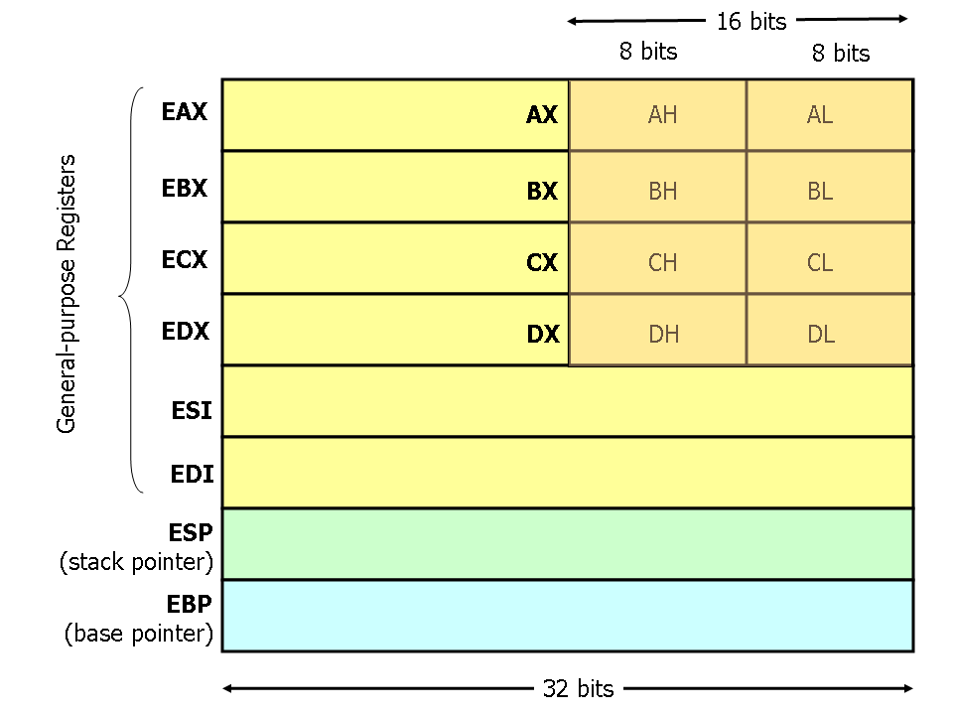
I. Hardware
Brain with no short-term memory
CPU
5
00001
How does it “execute” instructions?
??
00011
3
00101
It is sent instructions from another part of the computer
Executes instructions
…
00000000101000010001100000100000
11111
Must decipher what instruction to execute
Opcode
$rs
$rt
$rd
shamt
funct
$ denotes that it is a register

Slide 34
I. Hardware
Brain with no short-term memory
Registers
CPU
5
00001
How does it “execute” instructions?
??
00011
3
00101
It is sent instructions from another part of the computer
Executes instructions
…
00000000101000010001100000100000
11111
Must decipher what instruction to execute
Opcode
$rs
$rt
$rd
shamt
funct
ADD $rs, $rt, $rd

Slide 35
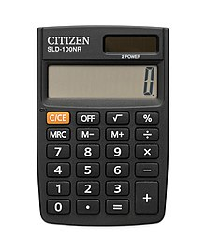
I. Hardware
Brain with no short-term memory
Registers
CPU
5
00001
How does it “execute” instructions?
??
00011
3
00101
It is sent instructions from another part of the computer
Executes instructions
…
00000000101000010001100000100000
11111
Must decipher what instruction to execute
Opcode
$rs
$rt
$rd
shamt
funct
ADD $rs, $rt, $rd
The CPU can add, subtract, logic, move stuff around

Slide 36
I. Hardware
Brain with no short-term memory
Registers
CPU
5
00001
How does it “execute” instructions?
8
00011
3
00101
It is sent instructions from another part of the computer
Executes instructions
…
00000000101000010001100000100000
11111
Must decipher what instruction to execute
Opcode
$rs
$rt
$rd
shamt
funct
ADD $rs, $rt, $rd
The CPU can add, subtract, logic, move stuff around

Slide 37
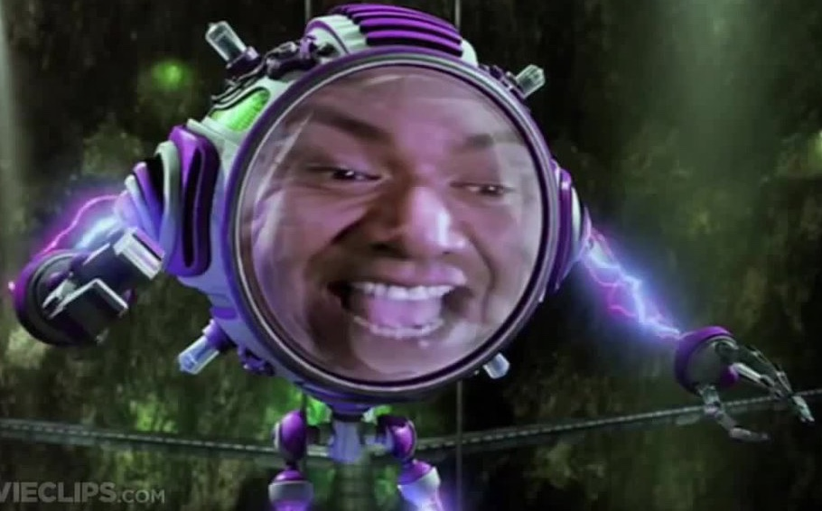
I. Hardware
Brain with no short-term memory
CPU uses
Registers
Electricity™
CPU
5
00001
How does it “execute” instructions?
8
00011
3
00101
It is sent instructions from another part of the computer
Executes instructions
…
00000000101000010001100000100000
11111
Must decipher what instruction to execute
Opcode
$rs
$rt
$rd
shamt
funct
ADD $rs, $rt, $rd
The CPU can add, subtract, logic, move stuff around

Slide 38
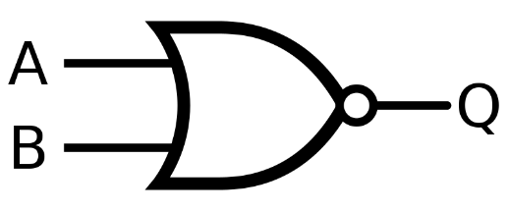
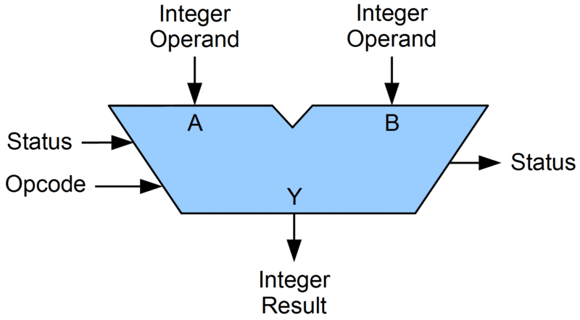
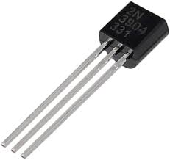
I. Hardware
Brain with no short-term memory
CPU uses
Registers
Electricity™
CPU
5
00001
How does it “execute” instructions?
8
00011
3
It is sent instructions from another part of the computer
00101
To decipher and execute instructions
Executes instructions
…
00000000101000010001100000100000
11111
Must decipher what instruction to execute
Opcode
$rs
$rt
$rd
shamt
funct
ADD $rs, $rt, $rd
The CPU can add, subtract, logic, move stuff around

Slide 39
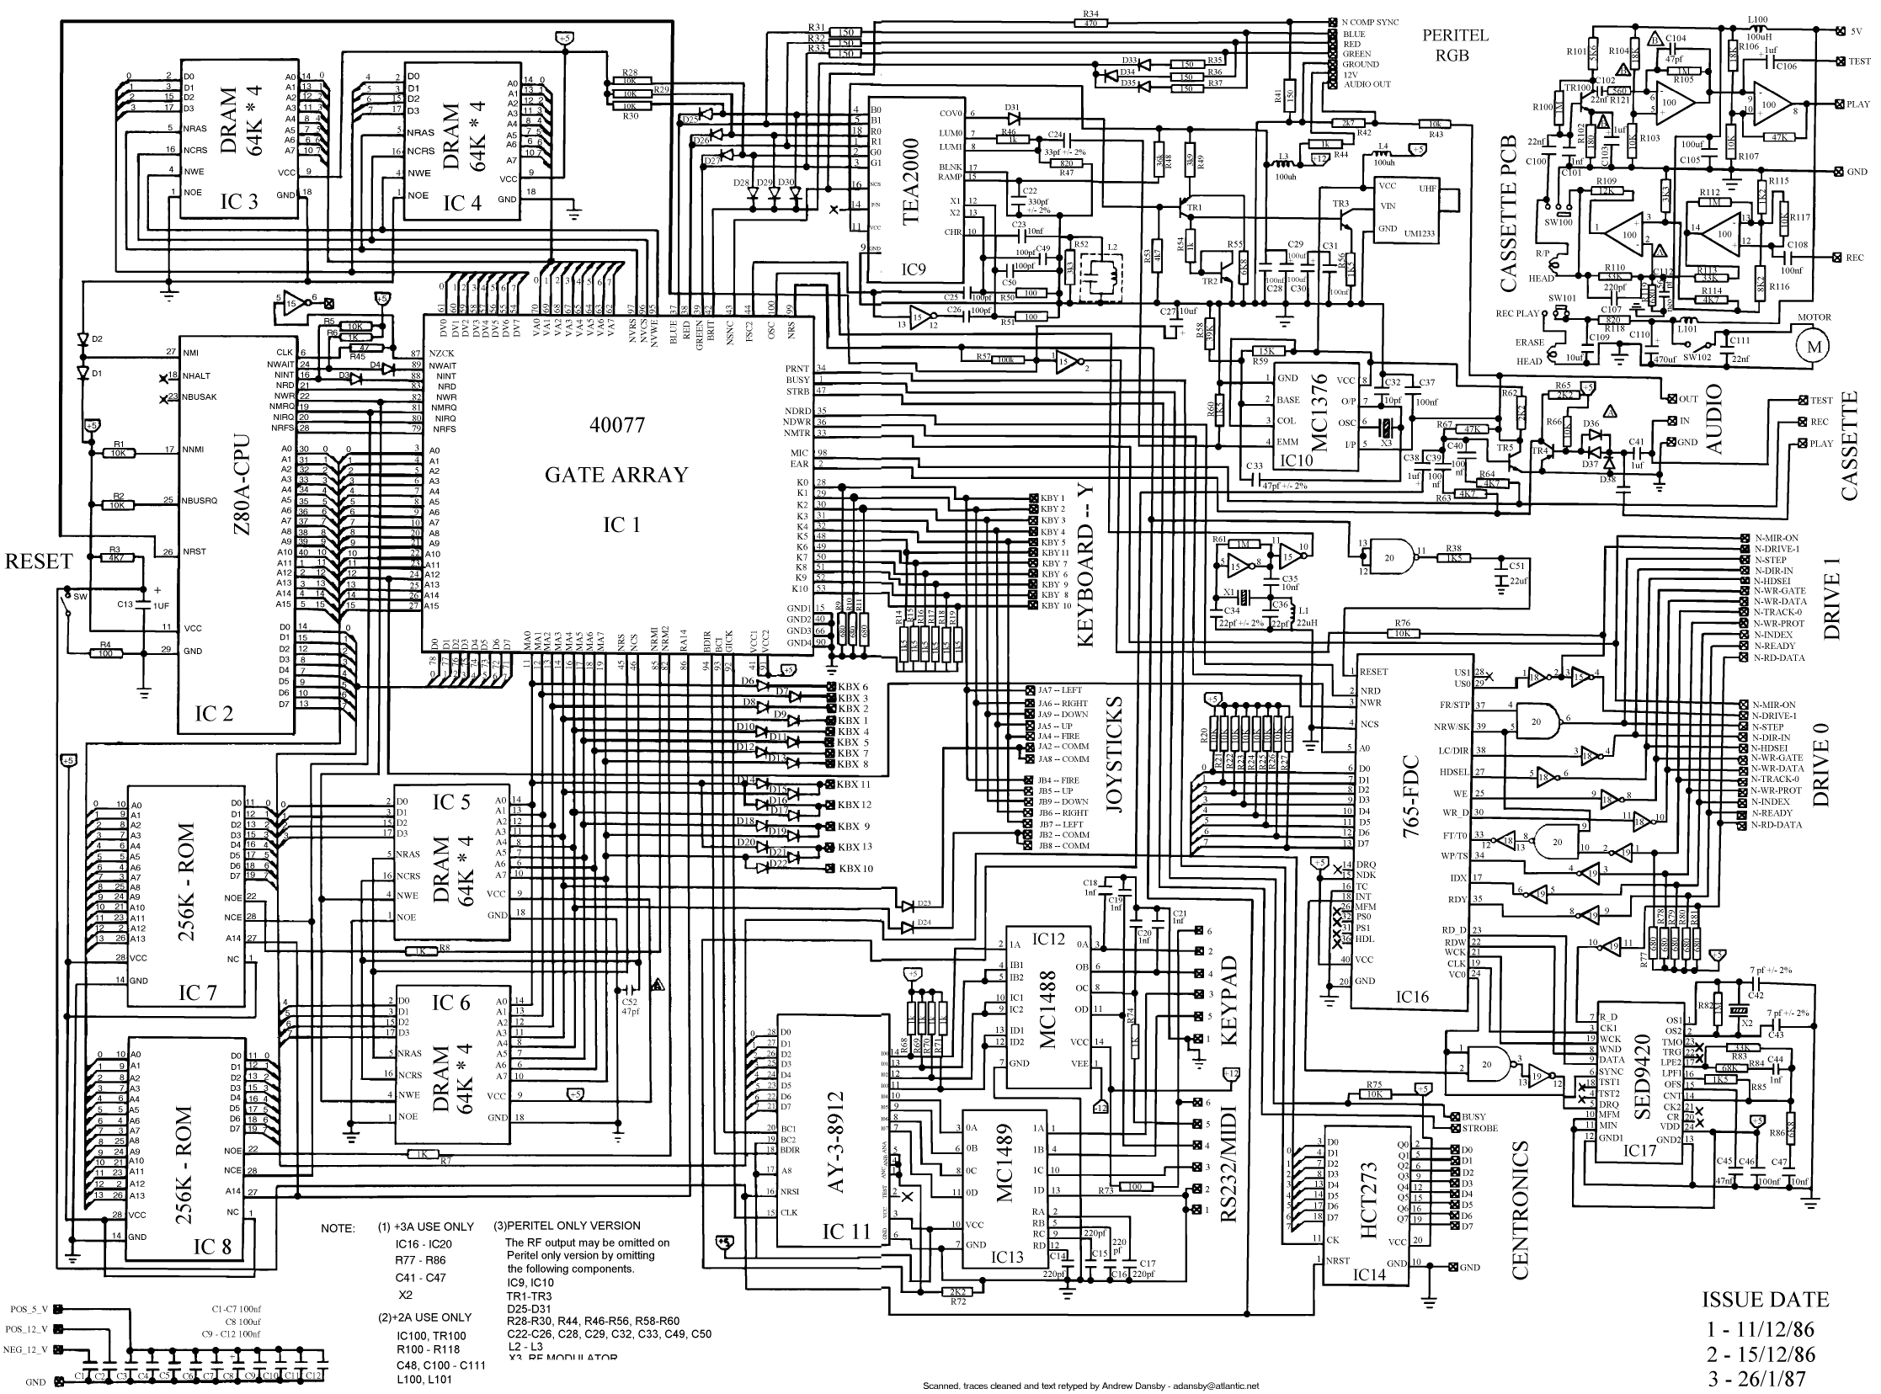
I. Hardware
Brain with no short-term memory
CPU uses
Registers
Electricity™
CPU
5
00001
How does it “execute” instructions?
8
00011
3
It is sent instructions from another part of the computer
00101
To decipher and execute instructions
Executes instructions
…
00000000101000010001100000100000
11111
Must decipher what instruction to execute
Opcode
$rs
$rt
$rd
shamt
funct
ADD $rs, $rt, $rd
The CPU can add, subtract, logic, move stuff around

Slide 40
I. Hardware
Brain with no short-term memory
CPU uses
Registers
Electricity™
CPU
5
00001
How does it “execute” instructions?
8
00011
3
It is sent instructions from another part of the computer
00101
To decipher and execute instructions
Executes instructions
…
00000000101000010001100000100000
11111
Must decipher what instruction to execute
Everything is just electricity on or electricity off
Opcode
$rs
$rt
$rd
shamt
funct
ADD $rs, $rt, $rd
The CPU can add, subtract, logic, move stuff around

Slide 41
I. Hardware
Brain with no short-term memory
Registers
CPU
5
00001
32 bit vs 64 bit?
8
00011
3
00101
Executes instructions
…
11111
Must decipher what instruction to execute
The CPU can add, subtract, logic, move stuff around

Slide 42
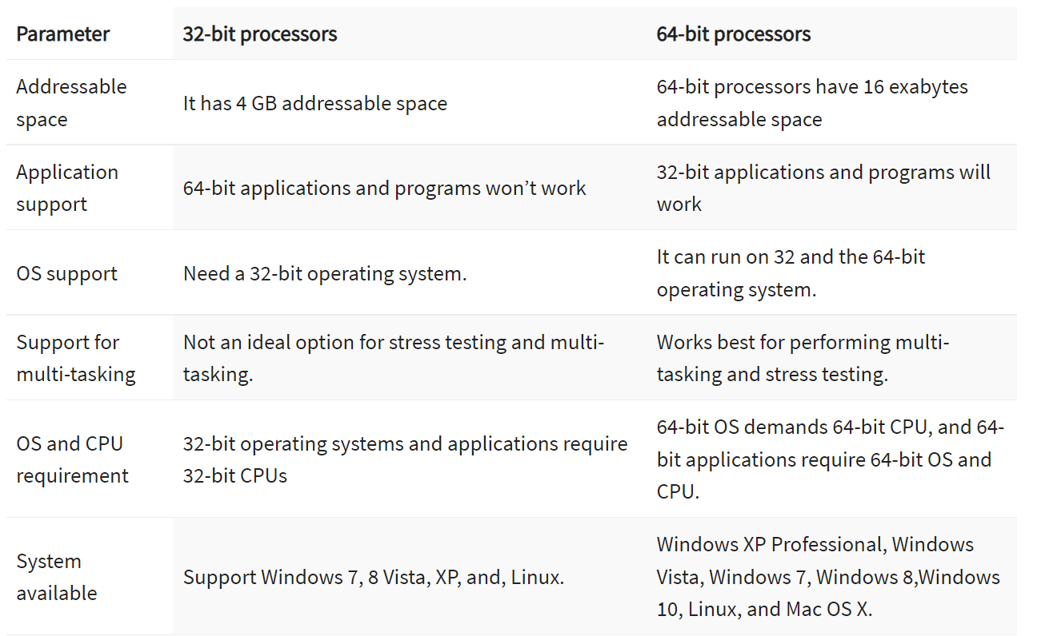
I. Hardware
Brain with no short-term memory
Registers
CPU
5
00001
32 bit vs 64 bit?
8
00011
3
00101
Executes instructions
…
11111
Must decipher what instruction to execute
The CPU can add, subtract, logic, move stuff around

Slide 43
How CPU is made:
https://www.youtube.com/watch?v=vuvckBQ1bME

Slide 44
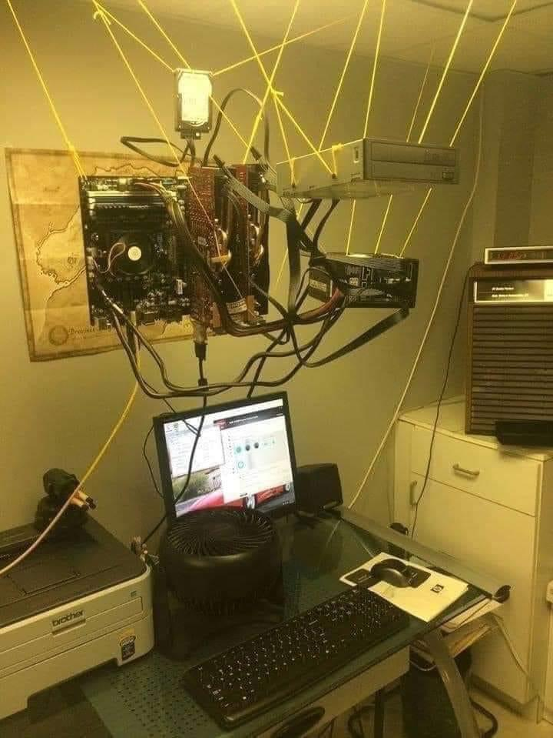
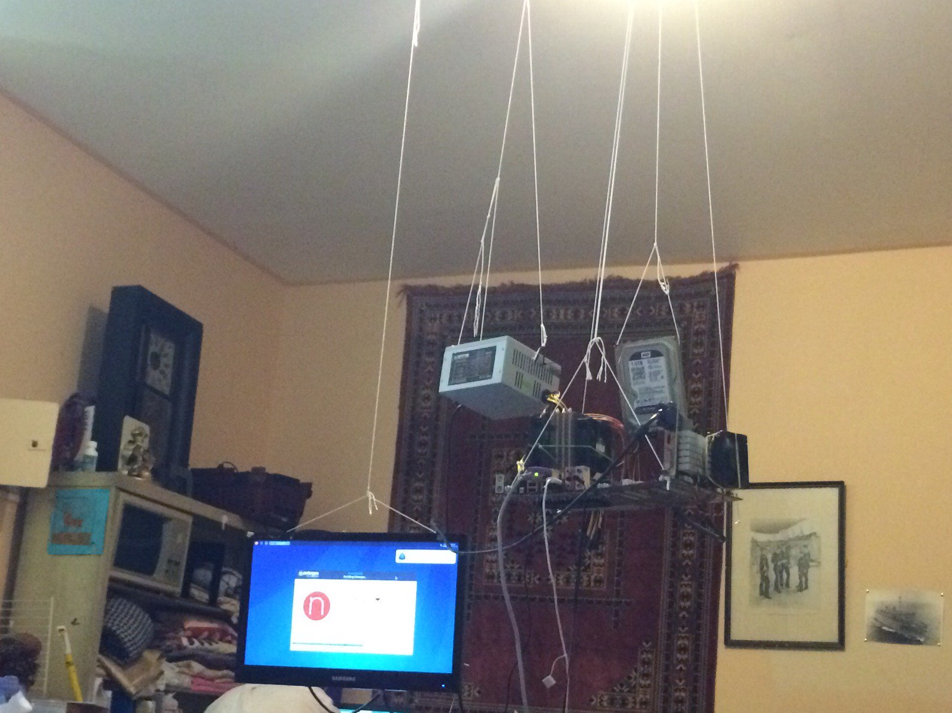
I. Hardware
Brain with no short-term memory
Registers
CPU
5
00001
32 bit vs 64 bit?
8
00011
3
00101
Executes instructions
…
11111
Must decipher what instruction to execute
The CPU can add, subtract, logic, move stuff around

Slide 45
I. Hardware
Brain with no short-term memory
Registers
Scratch Pad
CPU
5
00001
Memory
8
00011
3
00101
Executes instructions
…
11111
Must decipher what instruction to execute
The CPU can add, subtract, logic, move stuff around

Slide 46
I. Hardware
Scratch Pad
Memory
Instructions are stored here and prepared for the CPU
Instruction1
Instruction2
Instruction3
Instruction4
..
..
…

Slide 47
I. Hardware
Scratch Pad
Memory
When computer programs are executed, their instructions will eventually get stored in memory
Instructions are stored here and prepared for the CPU

Slide 48
I. Hardware
Scratch Pad
Memory
When computer programs are executed, their instructions will eventually get stored in memory
Instructions are stored here and prepared for the CPU
Permanently?!?!

Slide 49
I. Hardware
Scratch Pad
Memory
When computer programs are executed, their instructions will eventually get stored in memory
Instructions are stored here and prepared for the CPU
Main memory is volatile
Temporary storage

Slide 50
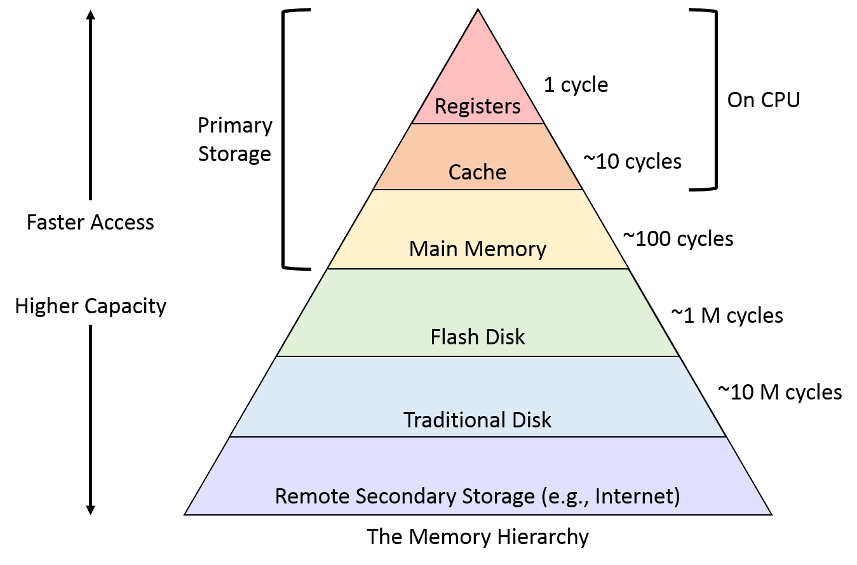
I. Hardware
The Memory Hierarchy
Scratch Pad
Memory
Instructions are stored here and prepared for the CPU
Temporary storage

Slide 51
I. Hardware
The Memory Hierarchy
Scratch Pad
Memory
Instructions are stored here and prepared for the CPU
Temporary storage

Slide 52
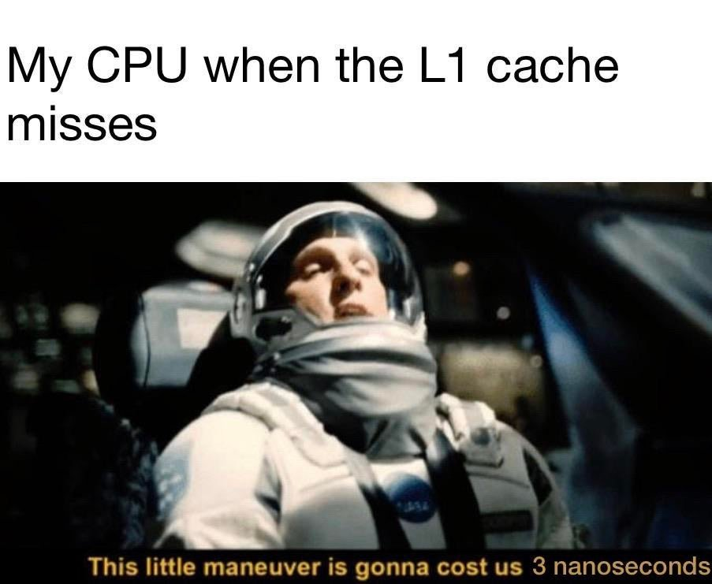
I. Hardware
The Memory Hierarchy
Scratch Pad
Memory
Instructions are stored here and prepared for the CPU
Temporary storage

Slide 53
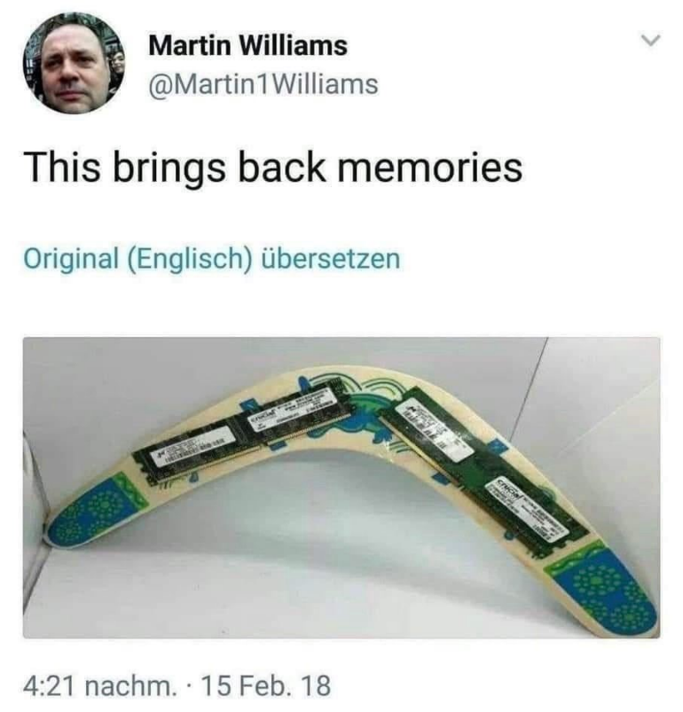
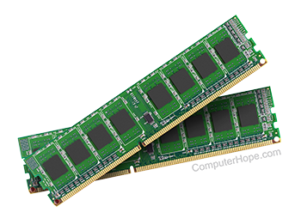
I. Hardware
The Memory Hierarchy
Scratch Pad
Memory
RAM
Instructions are stored here and prepared for the CPU
Temporary storage

Slide 54
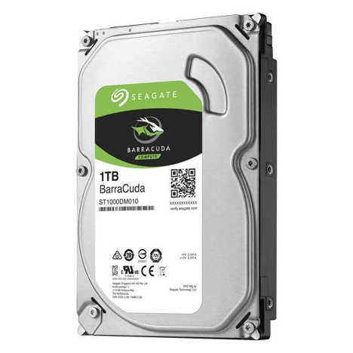
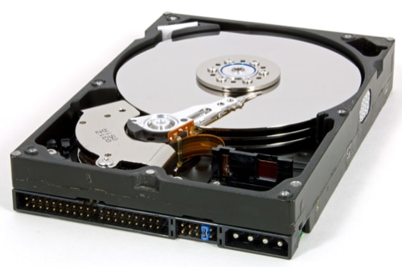
I. Hardware
The Memory Hierarchy
Scratch Pad
Memory
RAM
Instructions are stored here and prepared for the CPU
Temporary storage

Slide 55
I. Hardware
The Memory Hierarchy
Scratch Pad
Memory
RAM
Instructions are stored here and prepared for the CPU
Temporary storage
“The cloud”

Slide 56
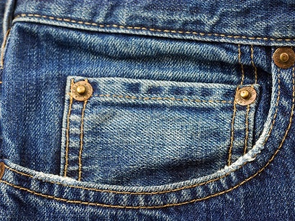
I. Hardware
The Memory Hierarchy
Scratch Pad
Memory
RAM
Instructions are stored here and prepared for the CPU
Temporary storage
“The cloud”

Slide 57
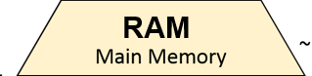
I. Hardware
Why not use memory/registers for everything??
The Memory Hierarchy
Scratch Pad
Memory
RAM
Instructions are stored here and prepared for the CPU
Temporary storage
“The cloud”

Slide 58
I. Hardware
Brain with no short-term memory
Registers
Scratch Pad
CPU
5
00001
Memory
8
00011
3
00101
Executes instructions
…
Instructions are stored here and prepared for the CPU
11111
Must decipher what instruction to execute
The CPU can add, subtract, logic, move stuff around
Temporary storage

Slide 59

I. Hardware
Brain with no short-term memory
Registers
Scratch Pad
CPU
5
00001
Memory
8
00011
3
00101
Executes instructions
…
Instructions are stored here and prepared for the CPU
11111
Must decipher what instruction to execute
1. Fetch next instruction
The CPU can add, subtract, logic, move stuff around
Temporary storage

Slide 60


I. Hardware
Brain with no short-term memory
Registers
Scratch Pad
CPU
5
00001
Memory
8
00011
3
00101
Executes instructions
…
Instructions are stored here and prepared for the CPU
11111
Must decipher what instruction to execute
Fetch next instruction
Decode Instruction
The CPU can add, subtract, logic, move stuff around
Temporary storage

Slide 61


I. Hardware
Brain with no short-term memory
Registers
Scratch Pad
CPU
5
00001
Memory
8
00011
3
00101
Executes instructions
…
Instructions are stored here and prepared for the CPU
11111
Must decipher what instruction to execute
Fetch next instruction
Decode Instruction
Execute Instruction
The CPU can add, subtract, logic, move stuff around
Temporary storage

Slide 62

I. Hardware
Brain with no short-term memory
Registers
Scratch Pad
CPU
5
00001
Memory
8
00011
3
00101
Executes instructions
…
Instructions are stored here and prepared for the CPU
11111
Must decipher what instruction to execute
Fetch next instruction
Decode Instruction
Execute Instruction
Store result*
The CPU can add, subtract, logic, move stuff around
Temporary storage

Slide 63
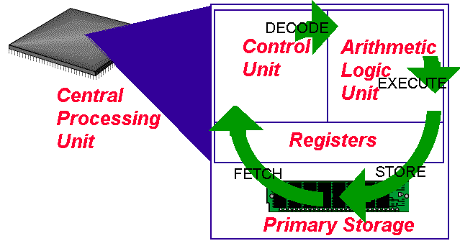

I. Hardware
Brain with no short-term memory
Registers
Scratch Pad
CPU
5
00001
Memory
8
00011
3
00101
Executes instructions
…
Instructions are stored here and prepared for the CPU
11111
Must decipher what instruction to execute
Fetch next instruction
Decode Instruction
Execute Instruction
Store result*
The CPU can add, subtract, logic, move stuff around
Temporary storage

Slide 64
I. Hardware
This process happens really fast

Slide 65
I. Hardware
This process happens really fast
… like really fast

Slide 66
I. Hardware
This process happens really fast
… like really fast
Computers can execute one instructions per clock cycle*

Slide 67
I. Hardware
This process happens really fast
… like really fast
Computers can execute one instructions per clock cycle*
4GHz CPU speed = 4,000,000,000 clock cycles per second

Slide 68

I. Hardware
This process happens really fast
… like really fast
Computers can execute one or more instructions per clock cycle*
4GHz CPU speed = 4,000,000,000 clock cycles per second

Slide 69
I. Hardware
This process happens really fast
… like really fast
Computers can execute one instructions per clock cycle*
4GHz CPU speed = 4,000,000,000 clock cycles per second
Multi-core systems are even faster

Slide 70
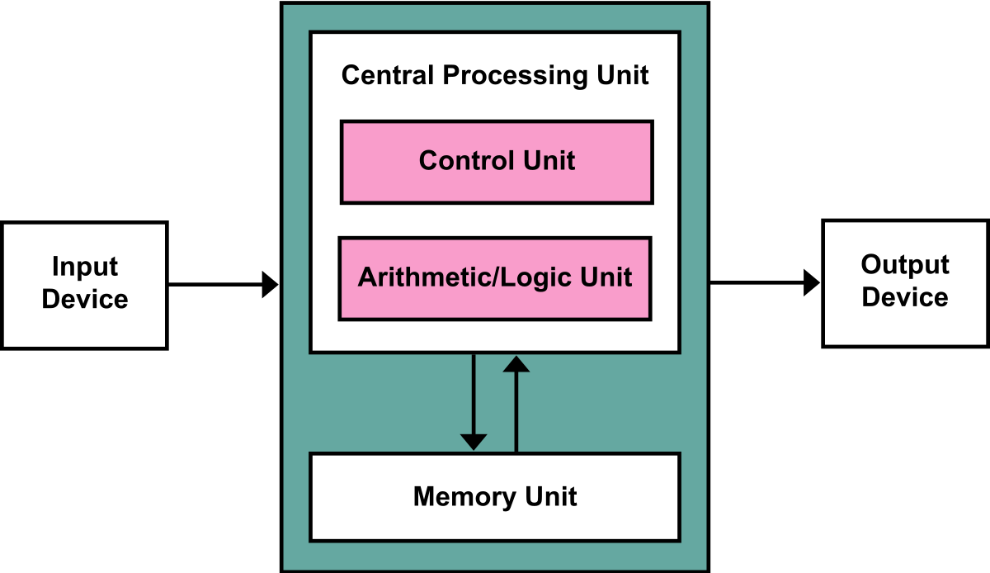
I. Hardware
Von Neumann Architecture

Slide 71
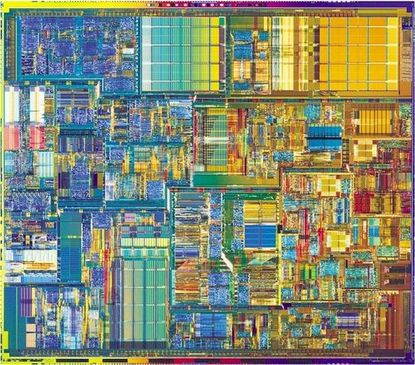
I. Hardware
Brain with no short-term memory
Registers
CPU
5
00001
8
00011
3
00101
Executes instructions
…
11111
Must decipher what instruction to execute
The CPU can add, subtract, logic, move stuff around

Slide 72
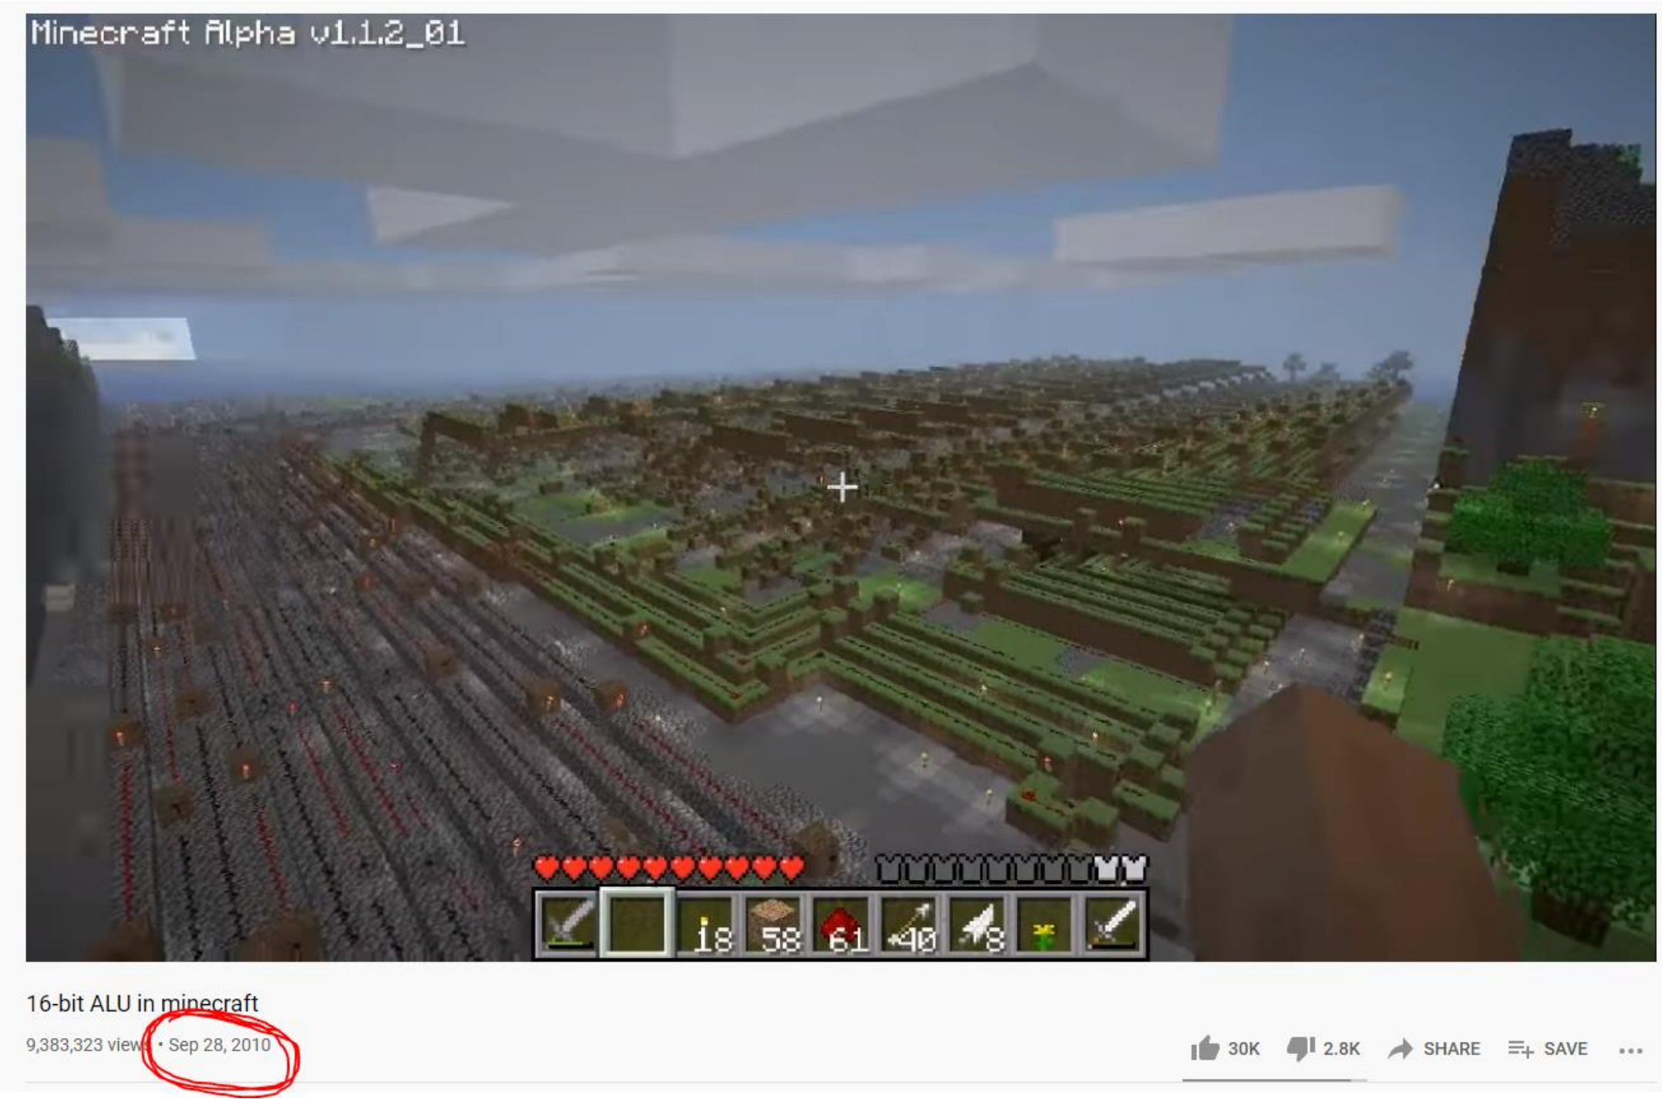
I. Hardware
Brain with no short-term memory
Registers
CPU
5
00001
8
00011
3
00101
Executes instructions
…
11111
Must decipher what instruction to execute
The CPU can add, subtract, logic, move stuff around
People have been able to create CPU components and fully functional, multi-core computers in games such as Minecraft

Slide 73
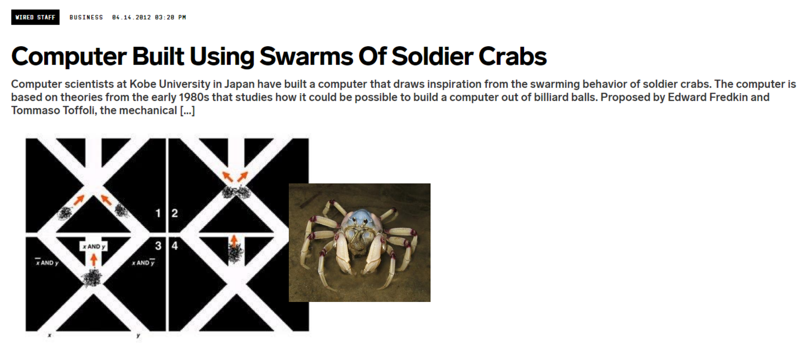
I. Hardware

Slide 74
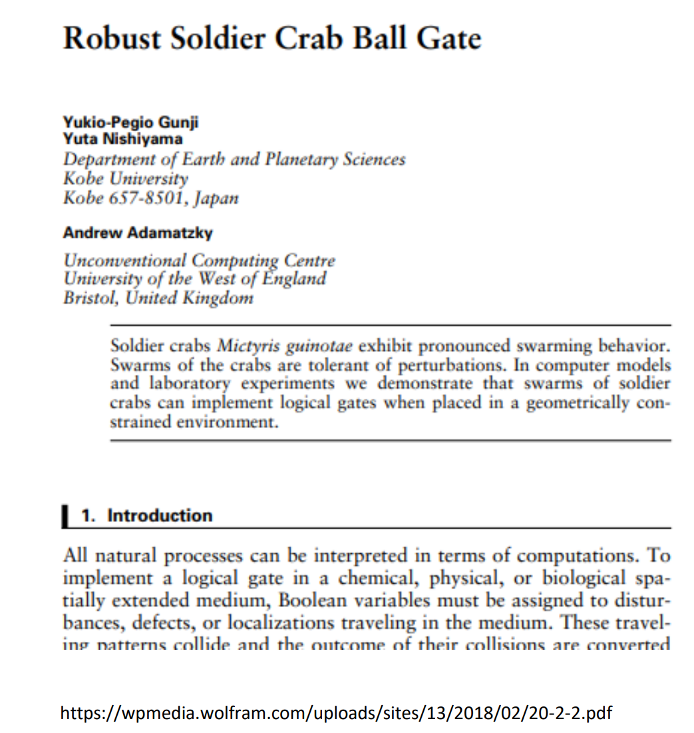
I. Hardware
This is very real

Slide 75

I. Hardware
(In theory) If you wanted to play Doom (1993) using a CPU made from soldier crabs, you would need 22 million crabs
(source: twitter)

Slide 76

How does this happen?
From a high level, we will divide a computer system into two parts
Software
Hardware
Software
Hardware
CPU
Memory

Slide 77






II. Software
A sequence of instructions, or program, that tells the computer how to work

Slide 78
01110011 00111011 01101111 01110101 01101100 01101110 01100111 01101001 01100001 00111011 01110011 01100111 01101110 00111011 01110011 01101011 01100100 01110110 01101110 01100001 00111011 01100100 01100111 01110100 00111011 01001111 01001100 01001011 01010011 01000100 01000110 00111011 01001100 01010011 01000100 01001000 01000111 01000100 01001100 00111011 01000110 01010011 01001011 01000111 01100110 01100100 01101000 01100100 01100110 01110011 01101000 01110011 01100110 01110111 01100101 01110111 01100101 01110010 01110111 01100101 01110010 01100110 01110110 01100111 01110011 01100100 01100010 01100100 01100110 01101000 01100010 01100100 01100110 01100100 01110011 01100100 01100110 01110011 01100100 01100110 01110011 01100100 01100110 01110011 01100100 01101000 01100100 01100110 01101000 01110011 01100100 01100110 01110011 01100100 01100110 01110011 01100100 01100110 01101000 01110100 01110010 01100100 01100110 01101000 01100100 01100110 01100111 01101000 01100110 01100111 01100111 01110100 01110010 01111001 01101000 01110100 01110010 01101000 01110010 01110011 01100110 01101000 01100111 01100110 01101000 01110011 01110010 01110100 01101000 01110100 01110010 01101000 01110011 01110100 01110010 01100100 01100110 01101000 01100100 01100110 01101000 01100100 01100110 01101000 01100100 01100110 01101000 01100101 01110111 01100110 01110011 01100100 01100110 01110010 01100101 01110111 01110100 01100111 01100101 01100111 01100100 01100110 01110011 01100111 01110011 01100110 0110010001110011 00111011 01101111 01110101 01101100 01101110 01100111 01101001 01100001 00111011 01110011 01100111 01101110 00111011 01110011 01101011 01100100 01110110 01101110 01100001 00111011 01100100 01100111 01110100 00111011 01001111 01001100 01001011 01010011 01000100 01000110 00111011 01001100 01010011 01000100 01001000 01000111 01000100 01001100 00111011 01000110 01010011 01001011 01000111 01100110 01100100 01101000 01100100 01100110 01110011 01101000 01110011 01100110 01110111 01100101 01110111 01100101 01110010 01110111 01100101 01110010 01100110 01110110 01100111 01110011 01100100 01100010 01100100 01100110 01101000 01100010 01100100 01100110 01100100 01110011 01100100 01100110 01110011 01100100 01100110 01110011 01100100 01100110 01110011 01100100 01101000 01100100 01100110 01101000 01110011 01100100 01100110 01110011 01100100 01100110 01110011 01100100 01100110 01101000 01110100 01110010 01100100 01100110 01101000 01100100 01100110 01100111 01101000 01100110 01100111 01100111 01110100 01110010 01111001 01101000 01110100 01110010 01101000 01110010 01110011 01100110 01101000 01100111 01100110 01101000 01110011 01110010 01110100 01101000 01110100 01110010 01101000 01110011 01110100 01110010 01100100 01100110 01101000 01100100 01100110 01101000 01100100 01100110 01101000 01100100 01100110 01101000 01100101 01110111 01100110 01110011 01100100 01100110 01110010 01100101 01110111 01110100 01100111 01100101 01100111 01100100 01100110 01110011 01100111 01110011 01100110 01100100
II. Software
A sequence of instructions, or program, that tells the computer how to work
Humans write code in binary ?

Slide 79
01110011 00111011 01101111 01110101 01101100 01101110 01100111 01101001 01100001 00111011 01110011 01100111 01101110 00111011 01110011 01101011 01100100 01110110 01101110 01100001 00111011 01100100 01100111 01110100 00111011 01001111 01001100 01001011 01010011 01000100 01000110 00111011 01001100 01010011 01000100 01001000 01000111 01000100 01001100 00111011 01000110 01010011 01001011 01000111 01100110 01100100 01101000 01100100 01100110 01110011 01101000 01110011 01100110 01110111 01100101 01110111 01100101 01110010 01110111 01100101 01110010 01100110 01110110 01100111 01110011 01100100 01100010 01100100 01100110 01101000 01100010 01100100 01100110 01100100 01110011 01100100 01100110 01110011 01100100 01100110 01110011 01100100 01100110 01110011 01100100 01101000 01100100 01100110 01101000 01110011 01100100 01100110 01110011 01100100 01100110 01110011 01100100 01100110 01101000 01110100 01110010 01100100 01100110 01101000 01100100 01100110 01100111 01101000 01100110 01100111 01100111 01110100 01110010 01111001 01101000 01110100 01110010 01101000 01110010 01110011 01100110 01101000 01100111 01100110 01101000 01110011 01110010 01110100 01101000 01110100 01110010 01101000 01110011 01110100 01110010 01100100 01100110 01101000 01100100 01100110 01101000 01100100 01100110 01101000 01100100 01100110 01101000 01100101 01110111 01100110 01110011 01100100 01100110 01110010 01100101 01110111 01110100 01100111 01100101 01100111 01100100 01100110 01110011 01100111 01110011 01100110 0110010001110011 00111011 01101111 01110101 01101100 01101110 01100111 01101001 01100001 00111011 01110011 01100111 01101110 00111011 01110011 01101011 01100100 01110110 01101110 01100001 00111011 01100100 01100111 01110100 00111011 01001111 01001100 01001011 01010011 01000100 01000110 00111011 01001100 01010011 01000100 01001000 01000111 01000100 01001100 00111011 01000110 01010011 01001011 01000111 01100110 01100100 01101000 01100100 01100110 01110011 01101000 01110011 01100110 01110111 01100101 01110111 01100101 01110010 01110111 01100101 01110010 01100110 01110110 01100111 01110011 01100100 01100010 01100100 01100110 01101000 01100010 01100100 01100110 01100100 01110011 01100100 01100110 01110011 01100100 01100110 01110011 01100100 01100110 01110011 01100100 01101000 01100100 01100110 01101000 01110011 01100100 01100110 01110011 01100100 01100110 01110011 01100100 01100110 01101000 01110100 01110010 01100100 01100110 01101000 01100100 01100110 01100111 01101000 01100110 01100111 01100111 01110100 01110010 01111001 01101000 01110100 01110010 01101000 01110010 01110011 01100110 01101000 01100111 01100110 01101000 01110011 01110010 01110100 01101000 01110100 01110010 01101000 01110011 01110100 01110010 01100100 01100110 01101000 01100100 01100110 01101000 01100100 01100110 01101000 01100100 01100110 01101000 01100101 01110111 01100110 01110011 01100100 01100110 01110010 01100101 01110111 01110100 01100111 01100101 01100111 01100100 01100110 01110011 01100111 01110011 01100110 01100100
II. Software
A sequence of instructions, or program, that tells the computer how to work
Humans write code in binary ?
NO

Slide 80



II. Software
We write programs in a readable, higher-level language

Slide 81
II. Software
We need a way to convert source code to binary

Slide 82
We need a way to convert source code to binary
II. Software
**THIS PROCESS IS NOT TRUE FOR EVERY LANGUAGE

Slide 83

We need a way to convert source code to binary
II. Software
Preprocessor
Removal of comments
Expand Macros
**THIS PROCESS IS NOT TRUE FOR EVERY LANGUAGE

Slide 84

We need a way to convert source code to binary
II. Software
Preprocessor
Compiler
Removal of comments
Expand Macros
Converted to assembly code
.s file
**THIS PROCESS IS NOT TRUE FOR EVERY LANGUAGE

Slide 85


We need a way to convert source code to binary
II. Software
Preprocessor
Compiler
Assembler
Removal of comments
Expand Macros
Converted to assembly code
.s file
**THIS PROCESS IS NOT TRUE FOR EVERY LANGUAGE

Slide 86
We need a way to convert source code to binary
II. Software
Preprocessor
Compiler
Assembler
Removal of comments
Expand Macros
Converted to assembly code
.s file
We still need to resolve function calls
i.e. printf, sleep, sqrt, etc
Linker
**THIS PROCESS IS NOT TRUE FOR EVERY LANGUAGE

Slide 87
We need a way to convert source code to binary
II. Software
Preprocessor
Compiler
Assembler
Removal of comments
Expand Macros
Converted to assembly code
.s file
Two methods:
Program A
Library 1
string.h
Library 2
Linker
stdio.h
**THIS PROCESS IS NOT TRUE FOR EVERY LANGUAGE

Slide 88
We need a way to convert source code to binary
II. Software
Preprocessor
Compiler
Assembler
Removal of comments
Expand Macros
Converted to assembly code
.s file
Program A
Static Linking- required code and data copied into executable at compile time
Linker
Library 1
Library 2
.exe
**THIS PROCESS IS NOT TRUE FOR EVERY LANGUAGE

Slide 89
We need a way to convert source code to binary
II. Software
Preprocessor
Compiler
Assembler
Removal of comments
Expand Macros
Converted to assembly code
.s file
Two methods:
Program A
Library 1
string.h
Library 2
Linker
stdio.h
**THIS PROCESS IS NOT TRUE FOR EVERY LANGUAGE

Slide 90
We need a way to convert source code to binary
II. Software
Preprocessor
Compiler
Assembler
Removal of comments
Expand Macros
Converted to assembly code
.s file
Two methods:
string.h
Library 1
Program A
Linker
stdio.h
Library 2
.exe
Dynamic Linking - required code and data is linked to executable at runtime
**THIS PROCESS IS NOT TRUE FOR EVERY LANGUAGE

Slide 91
We need a way to convert source code to binary
II. Software
Preprocessor
Compiler
Assembler
Removal of comments
Expand Macros
Converted to assembly code
.s file
Program A
To be continued
Linker
Library 1
Library 2
.exe
**THIS PROCESS IS NOT TRUE FOR EVERY LANGUAGE

Slide 92

How does this happen?
From a high level, we will divide a computer system into two parts
Software
print(“hello world!”)
Hardware
Software
Hardware
CPU
Memory

Slide 93

How does this happen?
From a high level, we will divide a computer system into two parts
Software
print(“hello world!”)
Hardware
Software
Hardware
CPU
Memory
Software is nothing without hardware

Slide 94
How does this happen?
From a high level, we will divide a computer system into two parts
Software
print(“hello world!”)
Hardware
Software
Hardware
CPU
Memory
Hardware is mostly nothing without software

Slide 95
How does this happen?
From a high level, we will divide a computer system into two parts
Software
print(“hello world!”)
Hardware
Software
???
Hardware
CPU
Memory

Slide 96
How does this happen?
Software
From a high level, we will divide a computer system into two parts
print(“hello world!”)
Operating System
Hardware
Software
Operating System
Hardware
CPU
Memory

Slide 97

Typical Layers of a Computer
The operating system is a vital component of a computer

Slide 98
Typical Layers of a Computer
The operating system is a vital component of a computer
What do we trust?
What do we not trust?

Slide 99
Typical Layers of a Computer
The operating system is a vital component of a computer
Not privileged
Privileged
Hardware

Slide 100

Typical Layers of a Computer
The operating system is a vital component of a computer
Not privileged
Privileged
Hardware

Slide 101
Typical Layers of a Computer
The operating system is a vital component of a computer
Not privileged
Privileged
Hardware

Slide 102
Typical Layers of a Computer
The operating system is a vital component of a computer
Not privileged
Privileged
?
Hardware

Slide 103

Meme credit: Carson Gross

